Slide 1

Get a Job!
CSC 143
Brian Cui

Slide 2
Disclaimer
But I have…
Been in your shoes, not long ago
Was an intern, not long ago
Interviewed, not long ago
I am…
Not a recruiter
Not a career expert
Not a hiring manager

Slide 3

So you want to be a Software Engineer?
Programming should be a passion
Problem solving should be a joy, not a chore
Be ready to learn and adapt quickly
"What's hot" changes all the time
C++, Java, Ruby, JavaScript, "AI/Machine Learning"
Be a people person*

Slide 4
Student to SWE
CS Student
SWE Intern
SWE Full-Time
Prime Directive: Get a summer internship!

Slide 5
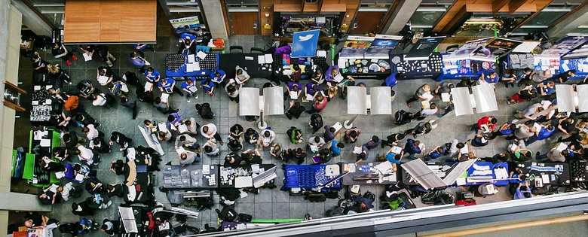
CS Student
SWE Intern
SWE Full-Time
Prime Directive: Get a summer internship!
For 90% of SWE internships, you need Data Structures (!)
Second-year students (you) > First year students
Meh company > No company
Some experience > No experience

Slide 6
CS Student
SWE Intern
SWE Full-Time
Prime Directive: Get a summer internship!
For 90% of SWE internships, you need Data Structures (!)
Second-year students (you) > First year students
Meh company > No company
Some experience > No experience

Slide 7





CS Student
SWE Intern
SWE Full-Time
Possible Timeline:
Year 1: Data Structures
Summer Internship at small-ish company
Year 2: Architecture
Summer Internship at medium-ish company
Year 3: Electives (Algorithms/AI/etc)
Summer Internship at big company
Year 4: ???
Full-time SWE

Slide 8
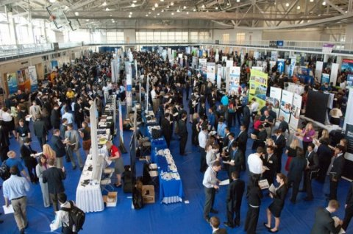
CS Student
SWE Intern
SWE Full-Time
Summer recruiting season is ~September through January
The earlier the better!
Ways to meet recruiters:
Career fairs
Applying Online
LinkedIn
Referrals

Slide 9

Selling Yourself
Resume
Thousands of Applicants
Hundreds of Interviews
Dozens of offers
How can you look good to a prospective employer?

Slide 10
RECRUITING: What candidates stand out?
Strong educational background
Good school, relevant classes, GPA*
Interesting portfolio
Work experience
Personal projects
Extracurriculars and leadership
Relevant skills
Languages, software, etc.
Thousands of Applicants
Hundreds of Interviews
Dozens of offers

Slide 11
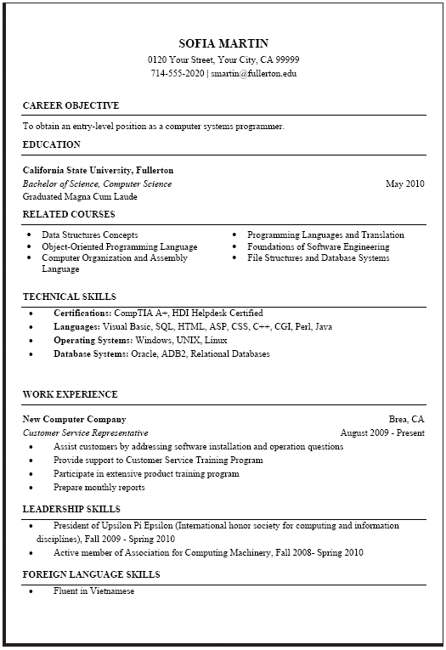
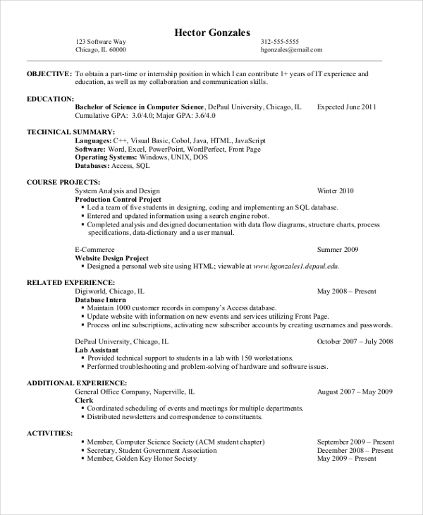
RECRUITING: You Are Your Résumé
Your resume is often the only thing recruiters know about you. It must be perfect.

Slide 12
RECRUITING: You Are Your Résumé
Education
Skills
Projects
Your resume is often the only thing recruiters know about you. It must be perfect.
Professional Experience
Extracurriculars

Slide 13
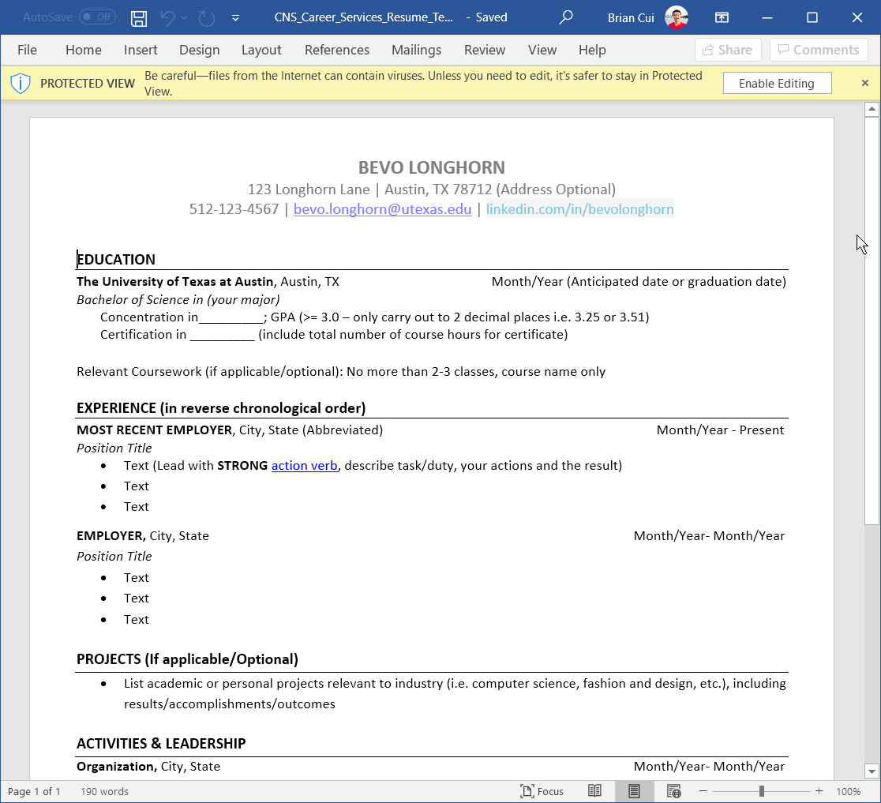
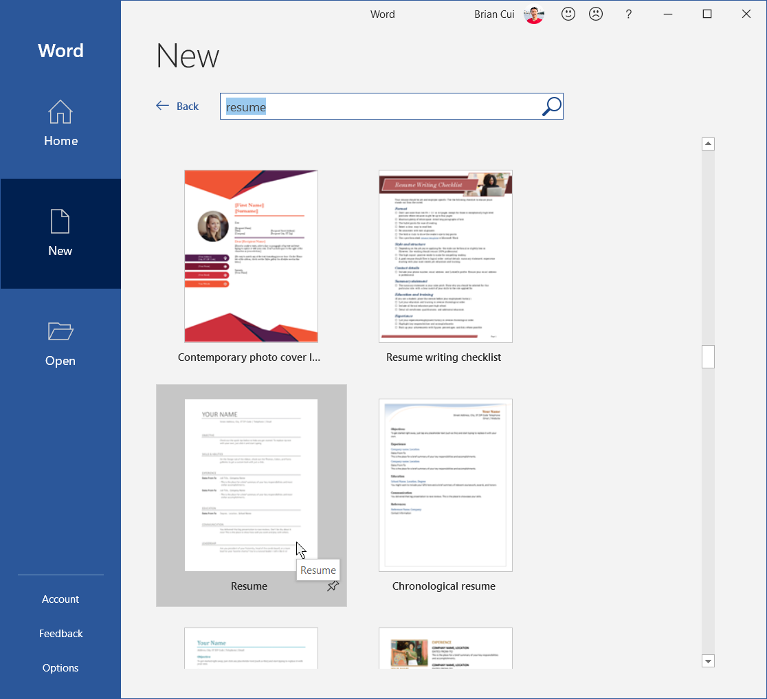

RECRUITING: How to make a Résumé?
Honestly? Start with Microsoft Word.
Free resume templates in Word
Templates also available online
https://cns.utexas.edu/career-services/students/resume-cover-letter
Build your own
Overall design doesn't matter that much,
All resumes are about the same

Slide 14

RECRUITING: Section: Education
List school and dates Show GPA? Rule of thumb is YES if >3.0

Slide 15
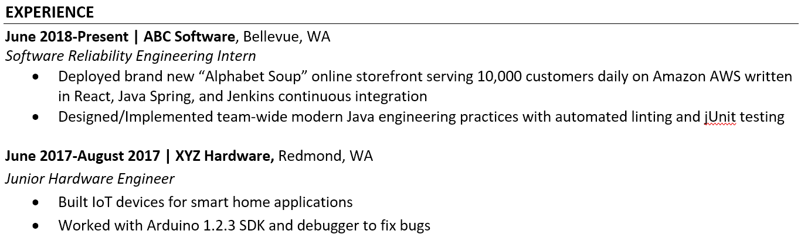
RECRUITING: Section: Experience
Professional BS? Sorta. Be descriptive and interesting. Keywords/Buzzwords fine, don't overdo it.

Slide 16
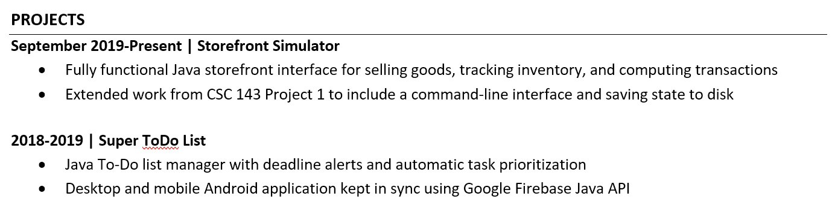
RECRUITING: Section: Projects
Excellent substitute for "Experience" Projects should be interesting; they don't have to be novel. Find something cool, learn about it.

Slide 17
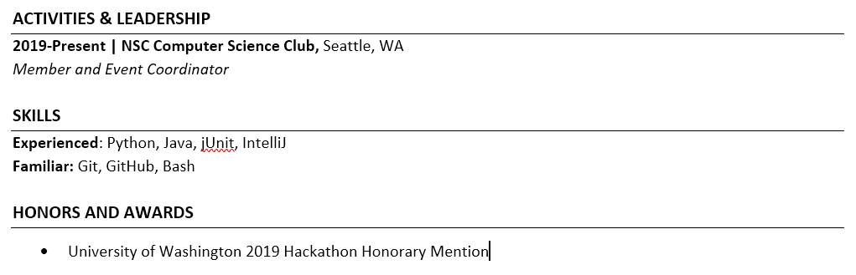
RECRUITING: Section: Extras
Extracurriculars are icing on the cake Participation in community events (e.g. hackathons, volunteering) show initiative

Slide 18
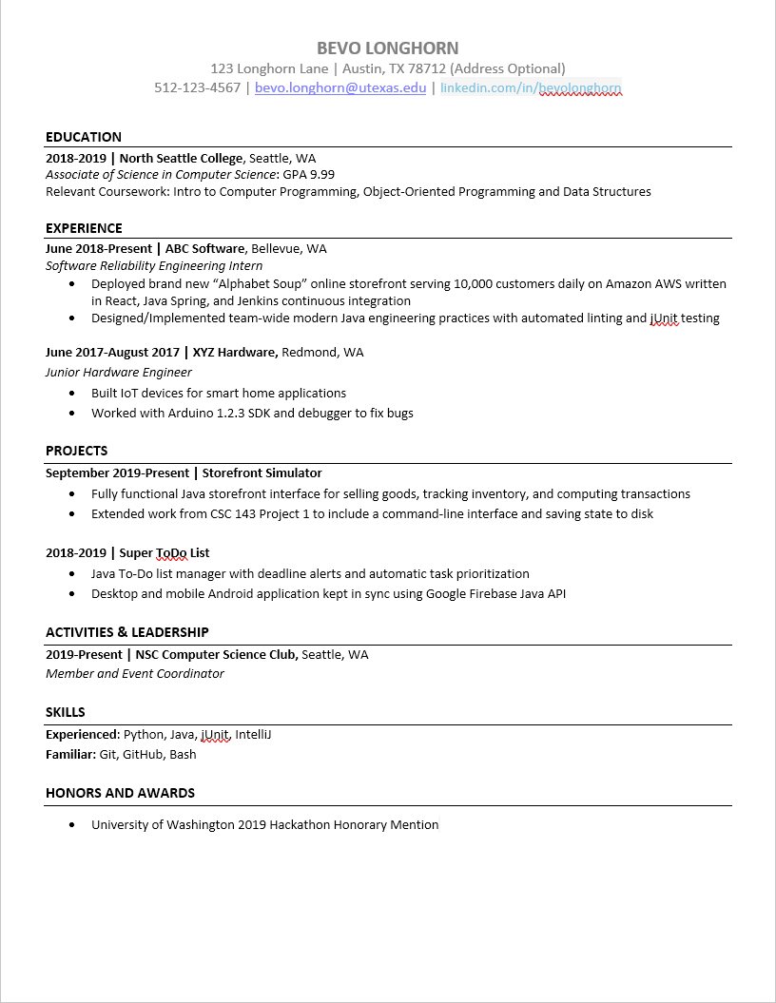
RECRUITING: Extra Pro-Tips
Keep your resume to one page max
No typos. Professionalism counts
More is better, but don't overdo it
Be proactive with recruiters
Get business cards
Send emails and check in
Attend special recruiting events
Be comfortable with rejection
No company is "the company"
Expect to be ghosted often

Slide 19

INTERVIEWING

Slide 20
INTERVIEWING: Timeline (for most companies)
Initial phone screening scheduling and confirmation
Usually takes place over email
Usually behavioral, sometimes technical
Phone or Campus Technical Interview
30 minutes to an hour
Whiteboarding or live coding (like Google docs)
On-site Technical Interviews
Company pays for trip to work location
Several (usually up to four) rounds of 1-hour whiteboarding

Slide 21


INTERVIEWING: What to Expect
One "difficult" technical problem
Reverse a singly linked list.
Implement a queue using two stacks.
Merge two sorted lists into a single sorted list.
Print a tree in row order.
Find the subrange in an array of integers that has the greatest sum.
In-person? Whiteboard only
No IDE, no test cases, no documentation

Slide 22
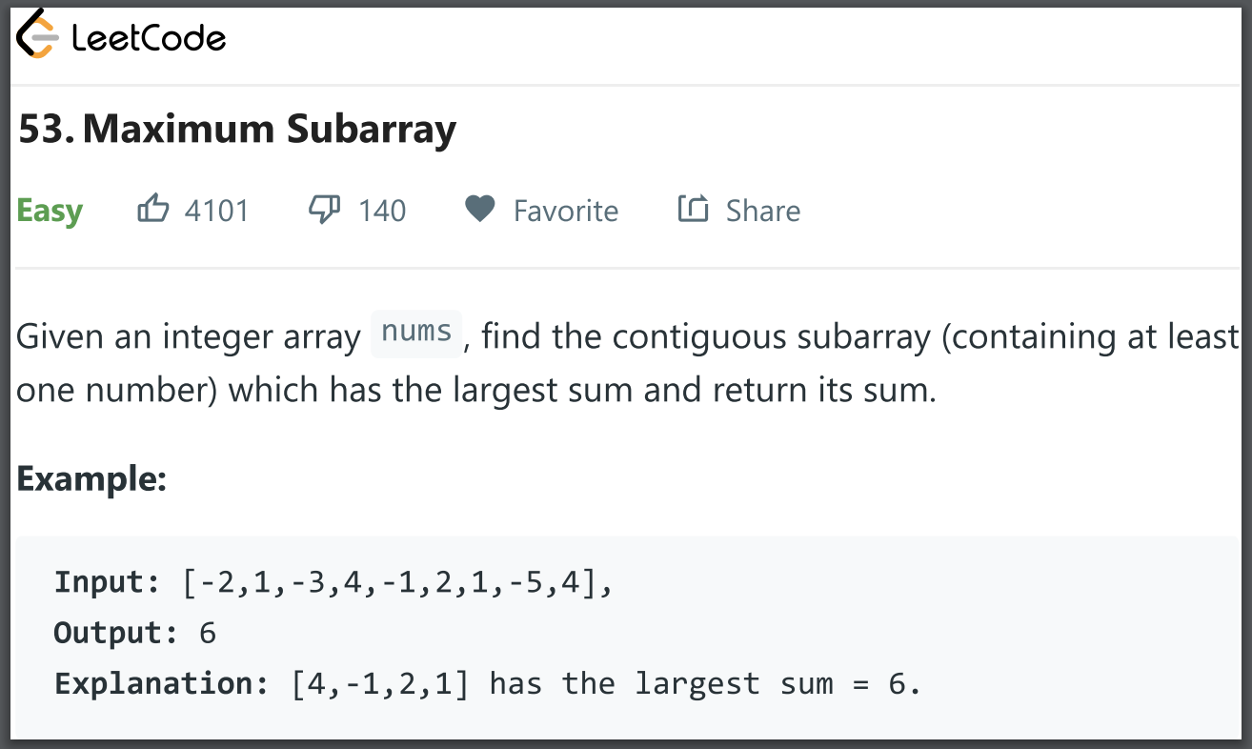
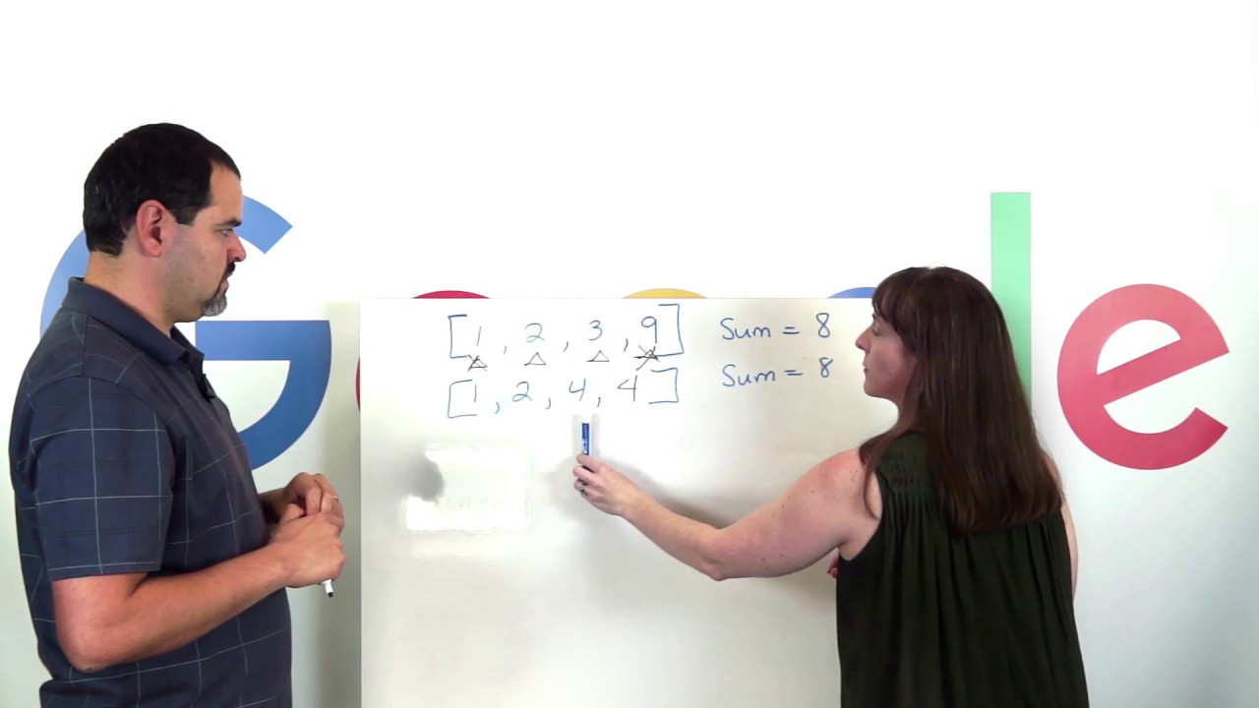
INTERVIEWING: How to Prepare
Practice, Practice, Practice
Write code with pen and paper
Have a friend interview you
Leetcode, HackerRank, CareerCup
Learn the company, bring questions
Be a people person*
Be friendly, not sassy
Be thankful and open-minded

Slide 23
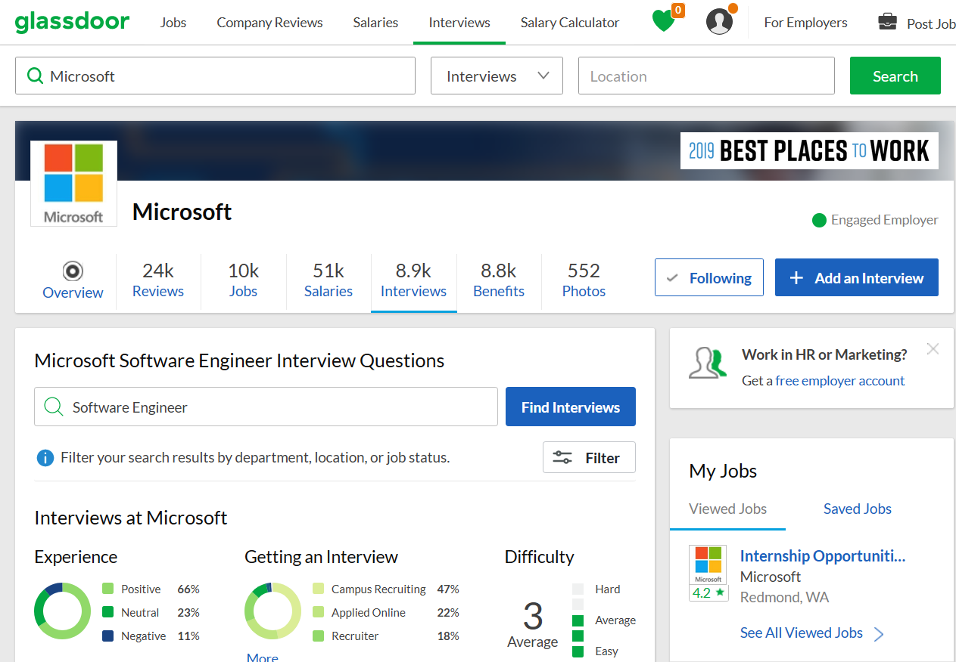
Do Your Research
"Knowing is half the battle." – GI Joe
Glassdoor (glassdoor.com) is an excellent resource for job reviews and insights.

Slide 24

THE OFFER

Slide 25
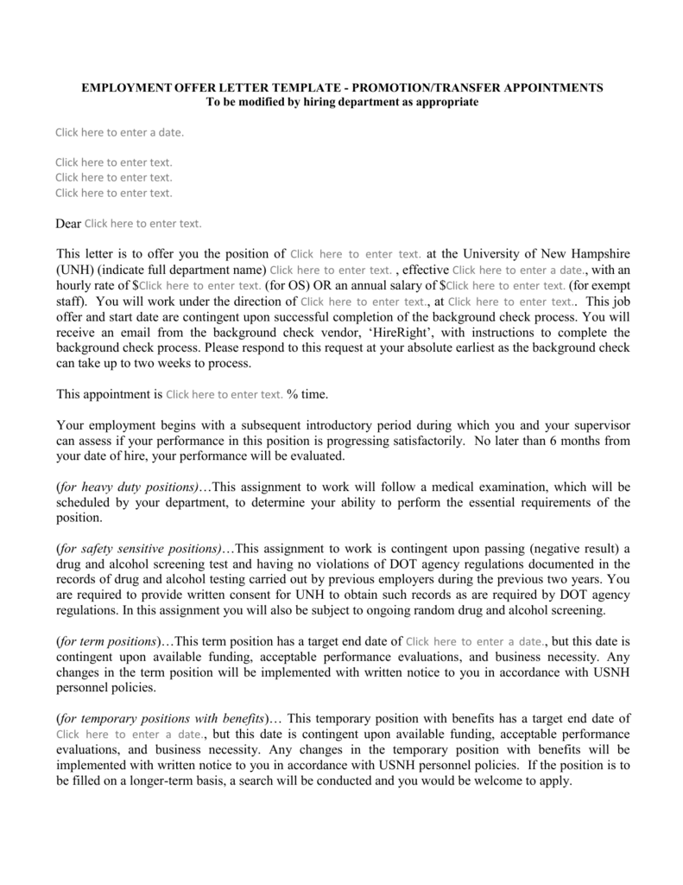

THE OFFER: Compensation and Benefits
Offers come with standard information:
Work Location
Work Dates (if contracted)
And, monetary compensation:
Hourly or Salaried Pay
Plus, bonuses (FTE only):
Signing Bonus
Starting Bonus
Stock Bonus

Slide 26


THE OFFER: Negotiation
Post-Offer Prime Directive: Always Negotiate Compensation!

Slide 27
THE OFFER: Negotiation
Post-Offer Prime Directive: Always Negotiate Compensation!
Don't be shy. Asking for more never hurts. You won't get rejected for trying (unless you're mean)
Know your worth. Leverage competing offers against each other, and check GlassDoor for comparable salaries.
Stay Humble. Be thankful and polite. Try to get your recruiter on your side.

Slide 28
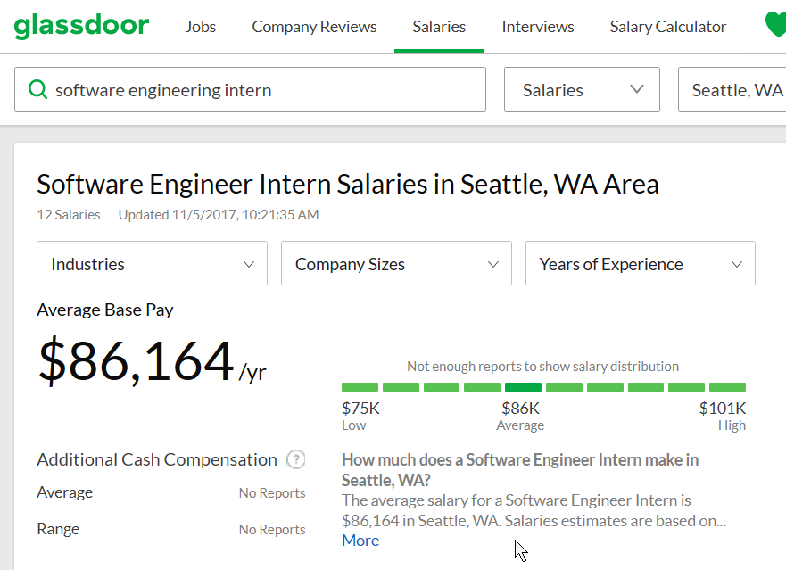
THE OFFER: Sample 📞
Post-Offer Prime Directive: Always Negotiate Compensation!
Recruiter: Hi, we'd like to offer you the position of SWE Intern at XYZ Corp.
You: Wow, thanks! That's very exciting; Tell me more?
Recruiter: Sure, the offer is for three months, starting in July. You'll be working in Seattle… you will be compensated $21 an hour.
You: Wow, great! That is excellent news, thank you. Is the offer negotiable?

Slide 29
THE OFFER: Sample 📞
Post-Offer Prime Directive: Always Negotiate Compensation!
Recruiter: It is, but we're limited in what we can change. What did you have in mind?
You: Well, the cost of living in Seattle is quite a bit higher. I also have a competing offer from ABC corp. Can you beat them at, say, $26 an hour?
Recruiter: Hmm… we can't get that close, but we may be able to confirm $24 an hour. How does that sound?
You: That sounds great!

Slide 30

THE OFFER: Making a Choice
When deciding between companies, think about:
Size: Big or small? Team sizes?
Culture: Move fast and break things?
Location: Cost of living? Lifestyle?
Money: Does it pay competitively?
Future: Can I advance my career here?
Consider contacting existing employees for insights.

